Slide 1



Importance Map
What is recalled from visual episodic memory?
Xi Wang, Kenneth Holmqvist, Marc Alexa
Notes:
Good evening everyone, first of all, thanks for deciding to stay so late and I hope you enjoy all the talks.
I am Xi, a PhD student in computer graphics at the technical university of Berlin.
The project I will describe to you today is about our proposal of generating an importance map, at least it could be one option. And it might allow us to experimentally probe the image content that has been recalled from visual episodic memory.
Let’s first start with an example. On the next slide there will be an image. Please feel free to look wherever you want and the total viewing time is only five seconds. Ready, lets go.

Slide 2

Notes:
four, three, two, one

Slide 3
What do you remember?
Notes:
All right, time is up. Now the question is what do you still remember from the image?
Here we see an overlaid fixation density map, which is generated by aggregating over many observers’ fixations. Red corresponds to the mostly fixated areas, but do you remember all of them?

Slide 4
◉
No correlation between visual attention and fixations
(Koivisto et al, 2004)
◉
Inattentional blindness – the Gorilla Experiment
(Memmert, 2006)
◉
Fixated regions are encoded?
Related work
Notes:
So far we know that sometimes observers fail to detect prominent objects in a scene. Studies have shown that visual attention and fixations are not always correlated, especially in a more controlled setup.
There is also the famous Gorilla experiment from the inattentional blindness paradigm showing that observers’ recognition of the Gorilla was independent of whether it has been fixated or not.
It seems so that fixation density map might not be able to capture what has been encoded or even comprehended by observers. Information contained in regions might not be processed even when they are fixated.

Slide 5
◉
Distinction between fixated regions that are recalled vs. those are not
Important map:= Fixated regions that are spontaneously recalled from visual episodic memory
Important regions are prioritized higher
◉
◉
Importance map
Notes:
In this work, we propose a new method to computationally distinguish between fixated regions that are recalled vs. those that are not.
More precisely, we define an importance map from the fixated areas that have been spontaneously recalled from visual episodic memory, assuming that the relative importance of the different scene regions is reflected in the prioritization during recall.
Of course there are many other possible definitions of importance, for example, by asking observers to compare image patches and evaluate their relative importance. Here we focus more on the spontaneous prioritization during recall.

Slide 6
◉
Eye movements during mental imagery
Looking-at-nothing phenomenon
- Fixations are reenacted during recall
(Johansson et al, 2006; Laeng et al, 2014)
- Function as spatial indices (Laeng and Teodorescu, 2002)
◉
Importance map
Notes:
Specifically, our method is based on findings in mental imagery studies which show we move our eyes while recalling an image in front of a homogenous area. This is often termed as the “looking-at-nothing” phenomenon. In the absence of visual features, eye movements is similar to that when the stimulus is presented. In particular, it has been shown that fixation locations during recall correspond to the locations of objects and they play a functional role in memory retrieval.

Slide 7

Experimental paradigm
t=0
Notes:
We follow the standard experimental paradigm used in mental imagery studies and here we see the structure of one trial.
First, the screen is black except for a white fixation dot in the center.

Slide 8
Experimental paradigm
t=0
t=0.5s
Notes:
Then an image is presented for 5 seconds and observer is asked to freely explore the image in order to later be able to recognize it.

Slide 9

Experimental paradigm
t=0
t=0.5s
t=5.5s
Notes:
After that, an image of white noise is shown for 1s, to destroy the after-image.

Slide 10
Experimental paradigm
t=0
t=0.5s
t=5.5s
t=6.5s
Notes:
Then the screen is set to grey for another 5 seconds, during which observer is asked to immediately recall the image from memory.

Slide 11
Experimental paradigm
t=0
t=0.5s
t=5.5s
t=6.5s
t=11.5s
Notes:
At the end, the screen turns back to black.

Slide 12

Image encoding
Notes:
Here we see a viewing sequence of one observer looking at one image for 5 seconds, where the size of each fixation corresponds to its duration.

Slide 13
Image recall
Notes:
Now we see the corresponding sequence of eye movements during recall of the same image, however, in front of a gray background without any visual features.

Slide 14
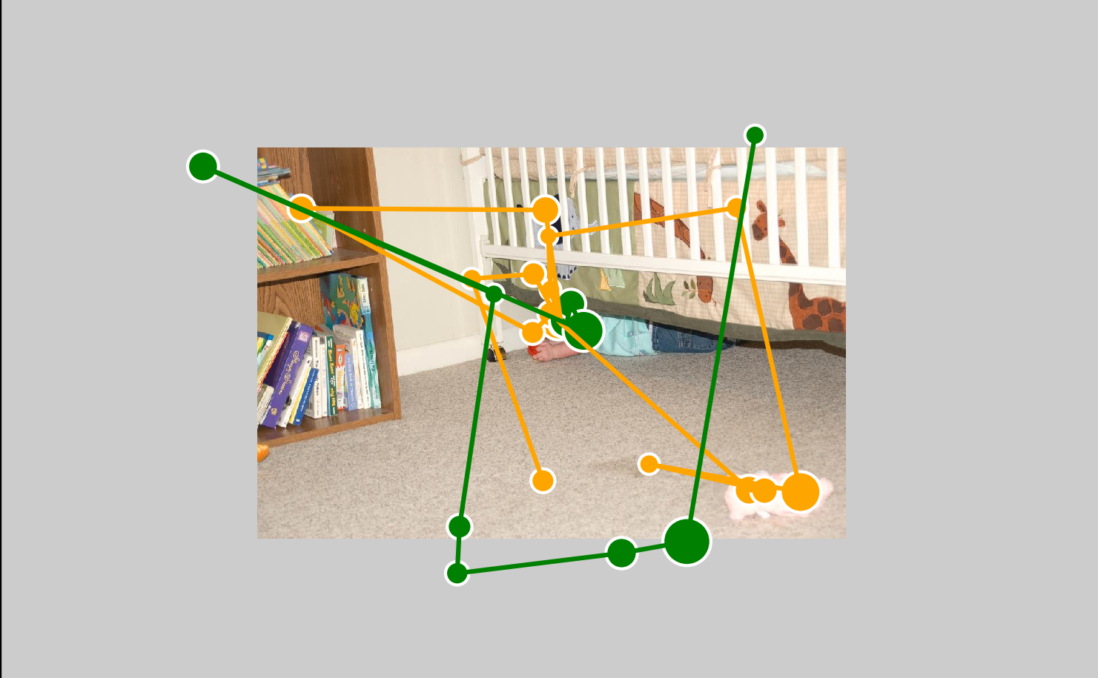
Which fixation has been recalled?
Notes:
By aligning two previous sequences together, we see that there is a qualitatively similarity between them.
However, eye movements during recall seem to be less accurate and there is no clear one to one correspondences.
This is well known that the locations of gaze during recall contain significant displacement. In order to know which fixation during encoding has been recalled, we need to first find a way to match them.

Slide 15
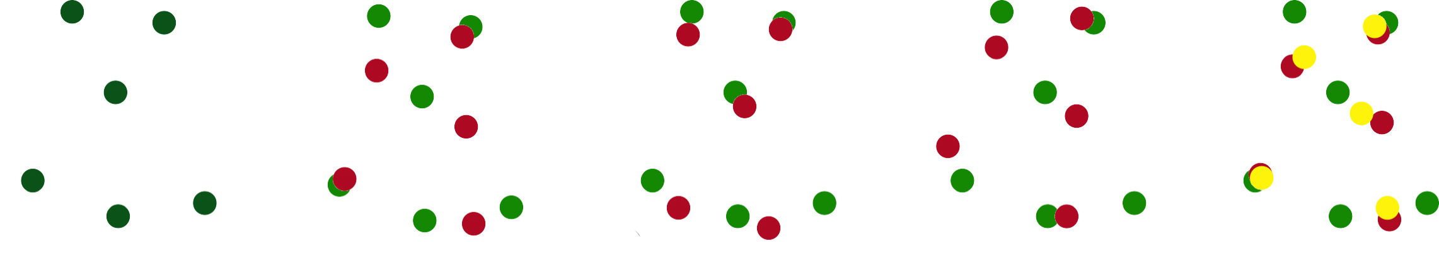
Goal: match recall to encoding
Encoding
Recall
Elastic matching
Notes:
We propose an elastic matching algorithm to compute a deformation mapping. Here we see an toy example where encoding fixations are shown in green and the corresponding recall fixations are in red.
Our goal is to deform the recall fixations so that they move closer towards the intended encoding fixations. More precisely, we want to match each fixation during recall to an encoding fixation that concerns the same visual element, assume there is one.

Slide 16
Goal: match recall to encoding
Rigid
Deformation
R+D
No reference – global rot. + trans.
Elastic matching
Local inaccuracies – deform.
Notes:
Due to the lack of reference during recall in front of a homogeneous area, a global transformation is often required, which includes rotation and translation. However, recall fixations also contain local inaccuracies and a rigid transformation alone doesn’t give desired results. Therefore we combine them and allow both global rigid transformation and local deformation. The deformed fixations are shown in yellow. Then we can simply use a matching radius to select the recalled fixations. Namely, each fixation during encoding is considered as being recalled only when it has a matched recall fixation nearby. In this toy example, four out of six fixations are considered as being recalled.
Many of you might be confused here and honestly I even don’t think I can understand it from such short explanation. But I am afraid we don’t have enough time to go more in depth and please refer to our manuscript for details.

Slide 17
Goal: match recall to encoding
Rigid
Deformation
R+D
Elastic matching
Dataset of
100 Images & 28 Participants
Notes:
We have conducted an experiment using 100 natural images as stimuli and collected data from 28 observers. For each image, we match the recall fixations to corresponding fixations during encoding and aggregate the remaining fixations into an importance map, similar to fixation density map.
Let me show you some interesting effects we observed in the results.
Failure cases
What is the goal? Briefly explain what is rigid and what is deformation

Slide 18

Stimulus
Encoding
Remembered
Results: low-level features
Notes:
First is the image stimulus, followed by its fixation density map overlaid on top. The importance map is shown in the last column.
Here we see an example related to low-level features, which contribute significantly to fixation-based attention models.
Notice that in this example the white box over a black background draw a lot of attention during encoding, however, it seems like later observers decide it is not worth remembering.

Slide 19
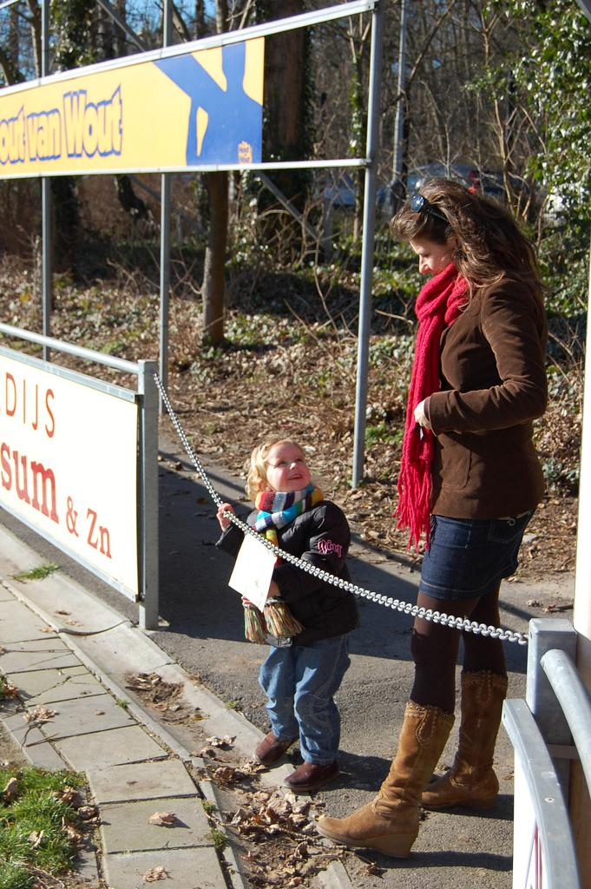
Stimulus
Encoding
Remembered
Results: semantics
Notes:
Text has been known to attract fixations during image inspection, however, like shown in this example, people seem to forget about them quickly, especially when they are not readable.

Slide 20

Stimulus
Encoding
Remembered
Results: semantics
Notes:
Similarly signs that are designed to convey information also seem to be less importance once the information has been decoded.

Slide 21

Stimulus
Encoding
Remembered
Results: people
Notes:
Here we see an image example which contains many small people that are largely forgotten.

Slide 22

Stimulus
Encoding
Remembered
Results: people
Notes:
But if people are large enough, they seem to be remembered during recall as shown in this example.

Slide 23
Results: people
Notes:
To see if there is a size effect, we draw bounding boxes over people in all 100 images, and the percentage of remembered fixations is plotted as a function of the size of the bounding box. As expected, small-sized people seem to be largely forgotten, but to a certain extend, people are remembered.
So the take-away message would be if you want to be remembered, try to be as large as possible.

Slide 24

Stimulus
Encoding
Remembered
Results: gaze following
Notes:
Another interesting effect is related to gaze following. Out of social convention, we know that observers tend to follow the gaze direction of the person in the image.
As shown in this example, the white bowl looked at by the person is also looked at by many participants during encoding of course there might be other reasons, but it is much less remembered.

Slide 25
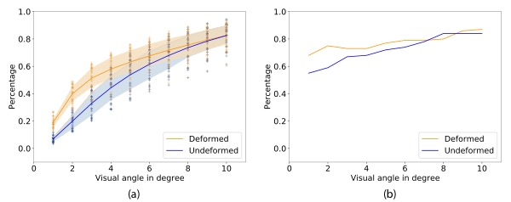
Results: quantitative results
Notes:
Apart from the examples we have seen, quantitative results also show that our matching algorithm systematically removes fixations that are less likely to be recalled.

Slide 26
◉
Importance map based on recall from episodic memory
Mental imagery paradigm
Proposed elastic matching algorithm
◉
◉
Encoding prioritization ≠ Recall prioritization
Summary
Notes:
To summarize the talk, we defined an importance map based on recall from episodic memory following the mental imagery paradigm. And we proposed an elastic matching algorithm to deal with the deformation in eye movements during recall.
Results indicate that the prioritization during encoding might be different from the prioritization during recall.

Slide 27
○
Ground truth for matching?
☑ Clicking shows consistent results
☐ Verbal description
☐ Self alignment of recall sequences
Current work
Notes:
There is the possibility that you think this project has a lot of novelty, not sure how high the chance is, but I think at least we would agree that this study might be less conventional, and there are many open questions. and our current work focuses on gathering ground truth data if there is such. Experimental data where observers clicked on the important regions show consistent results and we would like to continue comparing our importance map to the verbal description of observers, as well as the results generated by asking observers to align their own recall fixations. However, each approach might come with its own challenge, for example, we know from Mellisa’s work that it is hard to remember where we have looked, not to say where we have recalled.

Slide 28
Thank you
Xi Wang
xi.wang@tu-berlin.de
Importance map
Notes:
With that I would like to finish my talk and thank you for your attention.

